Slide 1


Your Community, Your Future
April 2014 Drop-in events

Slide 2

Welcome!
This event is about getting you involved in our Neighbourhood Development Plan
Please watch this brief introductory presentation which explains what you are being asked to do

Slide 3
What is a Neighbourhood Development Plan?
A Plan with local planning policies created by local people
It says how the ‘Herefordshire Core Strategy’ applies to our parishes
It will be part of the statutory Local Plan, so must be followed by planners when making decisions
It can include anything which is a ‘planning’ matter, including housing, design, environment, flood risks, heritage, traffic, facilities, sites for businesses
Last summer you said you wanted one…
… so the Humber, Ford & Stoke Prior Neighbourhood Development Plan project is underway…

Slide 4
The Project: producing our Plan
The project is led by a Steering Committee of parish councillors and other residents
It meets monthly in public – you’re welcome to come!
We’ve set up the project (including getting over £12,000 of grants for the costs)
We aim to agree and submit the Plan in early 2015…
..based on the views of everyone in the community

Slide 5
Now we want you to get involved…
What matters to you?
What should be in the Plan?
Where should new housing go?
What other development is needed and where?
What restrictions on development are needed?

Slide 6
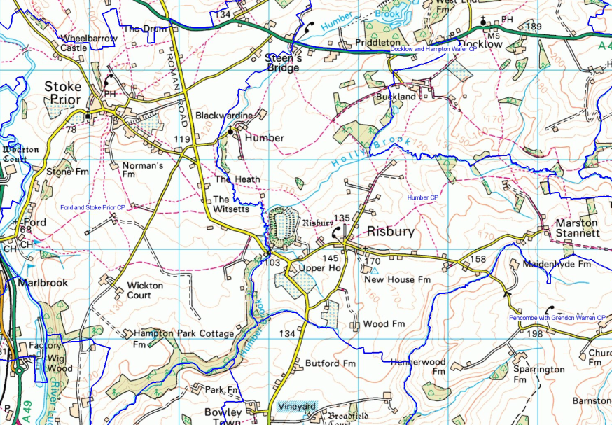
The Maps and
Comment Boards
Around the room are six themed boards
Go around each board pinning up your comments
You can also stick themed flags into the central maps
Everyone should be able to see everyone else’s comments
Steering Committee members are available to answer your questions

Slide 7
and while you’re doing that…
enjoy a free tea or coffee and cake
.. or a free soft drink
.. or buy a drink at Charlie’s Bar
get discussing the Plan with your neighbours…
...it’s Your Community
and Your Future!

